Slide 1




T2: MODELLING AND ANALYSIS OF AD-HOC NETWORKS
Justin P. Coon
Orestis Georgiou
Carl P. Dettmann
August 25th 2015
CNET-ICT-318177
Slides available at
https://goo.gl/4XwEcf

Slide 2






Introductions
Clemson University
University of Bristol
Research Manager at Toshiba TRL
Associate Professor
Oriel College
University of Oxford
University of Nottingham
University of Bristol
Max Planck Institute
for the Physics of Complex
Systems (MPIPKS)
Senior Researcher
Toshiba TRL - Bristol
University of Melbourne
University New South Wales
Northwestern
Copenhagen University
Rockefeller University
Professor
University of Bristol

Slide 3
Dense Cooperative Wireless Cloud Network
DIWINE - FP7 EU project 2013-2015 - €4m
Dense relay/node scenarios
Wireless Network Coding (WNC)
Distributed Synchronisation
Self-contained Wireless Cloud Network (WCN)
Source and destination are blind to the cloud network
Cloud self-organising and self-processing
“This concept facilitates energy-efficient, high-throughput and low-latency network communications performed directly at the physical layer, and is capable of operating in complicated, dense, randomly defined network topologies and domains”
Smart metering networks
Critical industrial control and monitoring applications

Slide 4
Tutorial Outline
Introduction / Motivation - OG
  Why, when and where decentralized can be better? Example applications
Modelling Random Networks - OG
  Setup and definitions, Network observables (coverage, node degree, k-connectivity)
From Infinite to Finite Networks - CD
  Asymptotics, Boundary effects, Examples
  Complex and fractal geometries
Advanced Topics - JC
  Scaling laws, Directional antennas, Small openings
Future directions and challenges - JC

Slide 5
Ad hoc Networks key ingredients
Decentralized (no central BS but scalable)
No pre-existing infrastructure
Self-configuring "on the fly" - anywhere, anytime
Multi-hop Routing (dynamic and adaptive)
  Table-driven (proactive) routing
  On-demand (reactive) routing
  Hybrid (both proactive and reactive) routing
  Hierarchical routing protocols (tree-based)
Mobility (MANETS & VANETS)
SmartPhone (SPANs) P2P-like, Bluetooth, WiFi-direct, LTE-direct

Slide 6
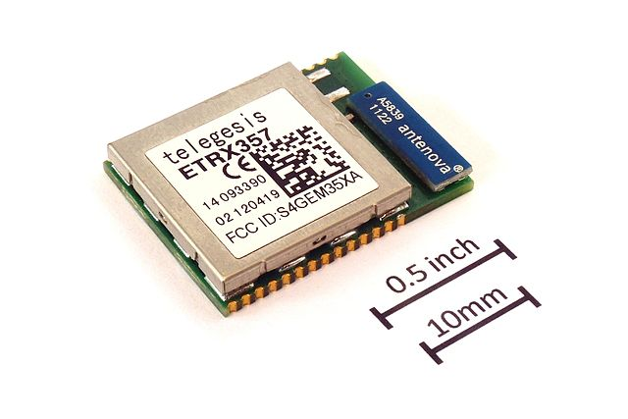


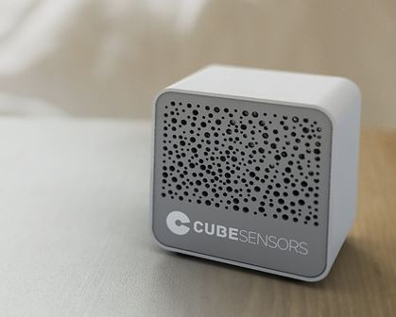
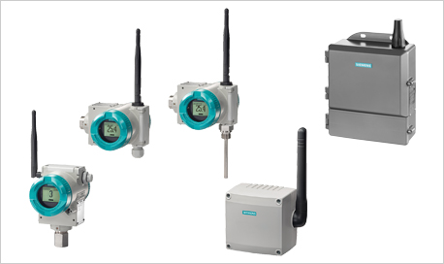

Applications of ad-hoc networks
Standardized under: IEEE 802.15.4
  ZigBee, WirelessHART, ISA100.11a, and MiWi
Wireless sensor networks (WSN)
  Environmental, Agricultural, Industrial, Military
  Disaster relief solutions
Building automation
  Smart metering, Industrial control
Internet of Things

Slide 7
Tutorial Outline
Introduction / Motivation
  Why, when and where decentralized can be better? Example applications
Modelling Random Networks
  Setup and definitions, Network observables (coverage, node degree, k-connectivity)
From Infinite to Finite Networks
  Asymptotics, Boundary effects, Examples
  Complex and fractal geometries
Advanced Topics
  Scaling laws, Directional antennas, Small openings
Future directions and challenges

Slide 8
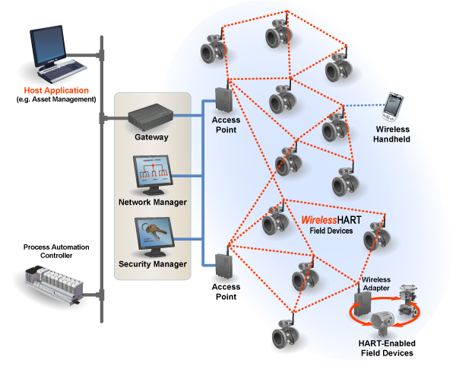
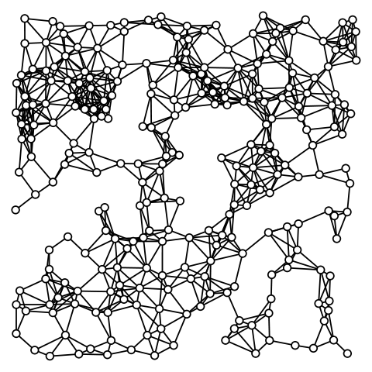
Modelling ad hoc (random) networks
A statistical framework

Slide 9
Modelling ad hoc (random) networks
  Number and Location of wireless devices
    Ad hoc, mobile, physical constraints and costs
  Multipath (fast fading)
  Shadowing (slow fading)
  Power control
    Cooperation - signalling overheads
  MAC protocols
    TDMA / FDMA / CDMA /SDMA ...
    ALOHA / CSMA / CD / CA (802.11)
  Directional antennas
  Multiple antennas
  Transmission scheme (MRC / STBC)

Slide 10
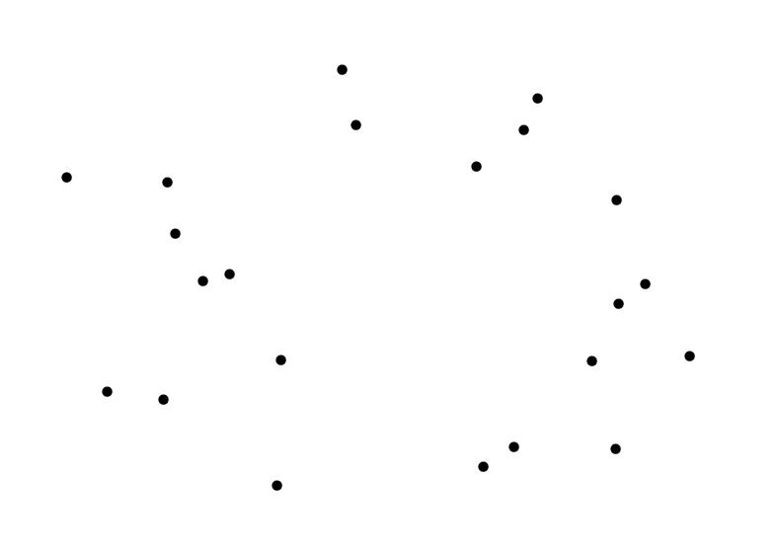
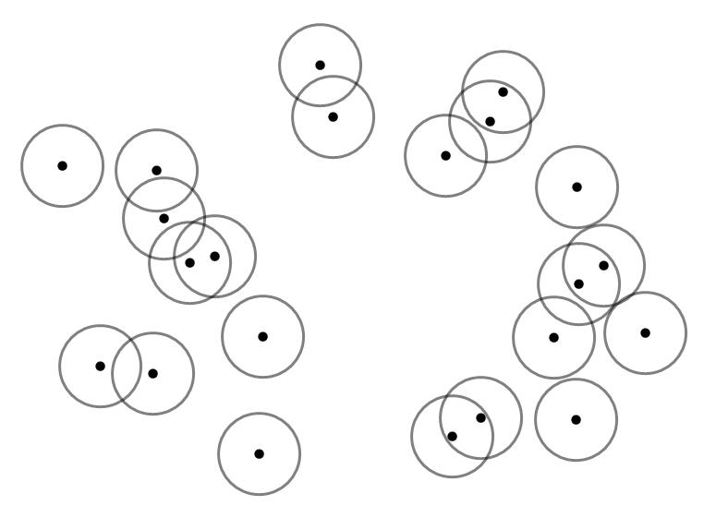
Random geometric network
Notes:
A random geometric network consist of a collection of points which are randomly scattered over a region of space according to some probability distribution in this case uniformly.
Any two points separated by a distance less than a certain specified value are said to be connected and group together to form a cluster.

Slide 11
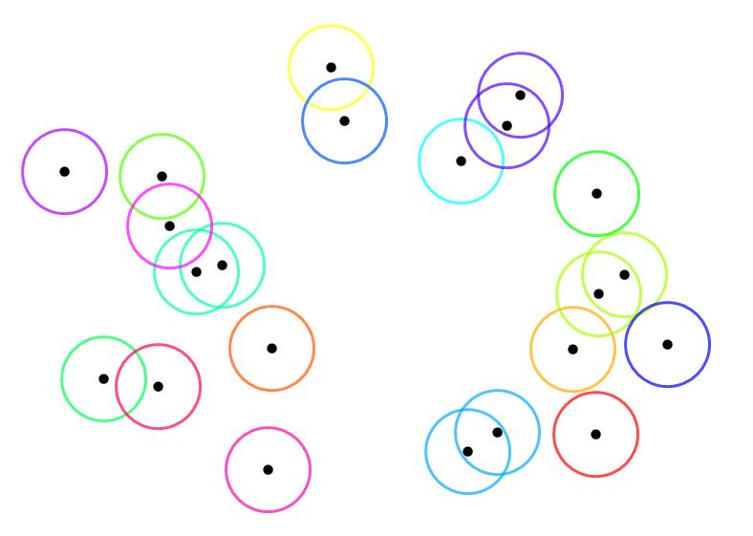
Random geometric network
1. G. Gilbert, “Random plane networks,” SIAM J., vol. 9, no. 4, pp. 533–543, 1961.
2. M. D. Penrose, “Random Geometric Graphs”, Oxford University Press, 2003.
3. M. Franceschetti, R. Meester, ”Random networks for communication: from statistical physics to information systems”. Vol. 24. Cambridge University Press, 2008.
4. M. Walters, “Random Geometric Graphs,” in Surveys in Combinatronics 2011 (Robin Chapman, ed.), Cambridge University Press, 2011

Slide 12
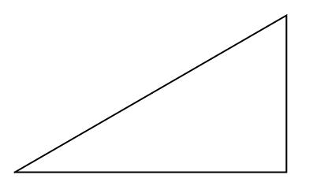
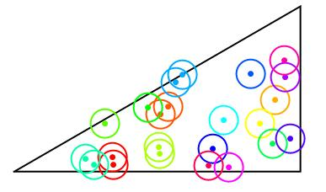
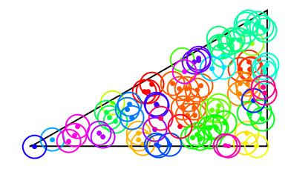
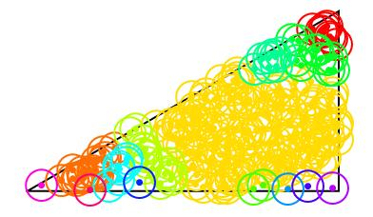
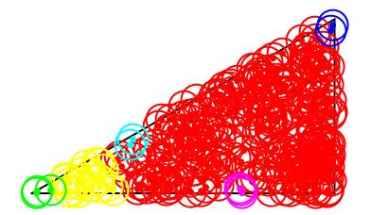

Confined Random geometric networks
What is the probability of achieving a fully connected network at a given density?

Slide 13
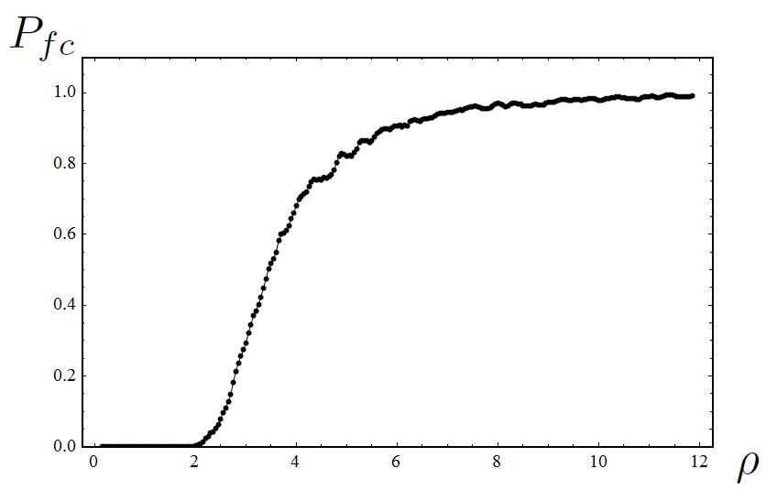


Confined Random geometric networks
Probability of Full connectivity
The goal is to develop a theory for that is able to provide useful analytic and physical insight which can support a variety of connectivity models, and can act as a basis for further development and analysis. To this end we will derive a general formula for which is simple, intuitive and practical.

Slide 14

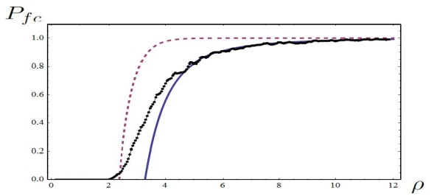

Introduction / Motivation
A short summary:
  Ad hoc networks - applications and standards
  What is a random geometric network?
  Stated the problem of Full connectivity in spatially confined domains

Slide 15
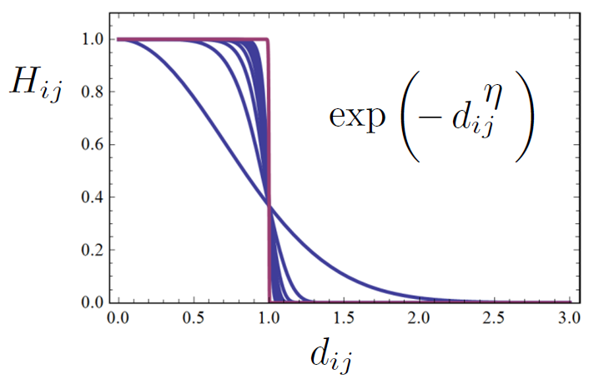

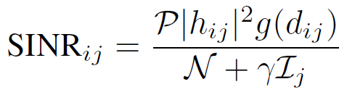

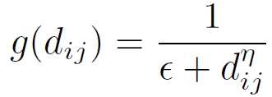



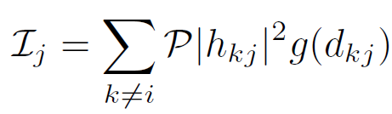
Pairwise Connection function
Complement of outage probability
Path loss attenuation function
Path loss exponent
Channel gain
Interference factor
F. Baccelli, and B. Blaszczyszyn. Stochastic geometry and wireless networks: Theory. Vol. 1. Now Publishers Inc, 2009.
Total Interference at j
M. Haenggi. Stochastic geometry for wireless networks. Cambridge University Press, 2012.

Slide 16
Pairwise Connection function
Rayleigh Fading
Hard = Deterministic
Soft = Stochastic/Probabilistic

Slide 17

Pairwise Connection function
Rayleigh Fading
(CLT)
Rician Fading

Slide 18

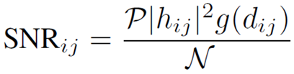

Pairwise Connection function
Channel gain
Complement of outage probability
Path loss attenuation function
Path loss exponent

Slide 19
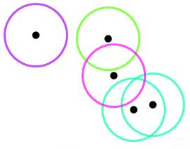
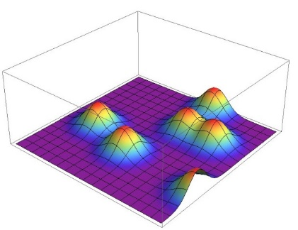
Pairwise Connection function
H is the pair connection function: the probability that two nodes are directly “connected”
Deterministic
Probabilistic
Randomness (is good):
  Number and Location of wireless devices
  Multipath (fast fading)
  Directional antennas
  Multiple antennas

Slide 20
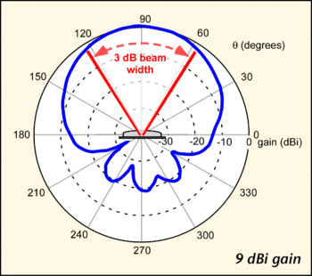
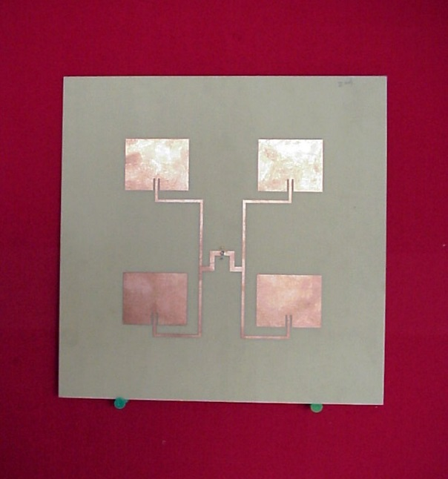
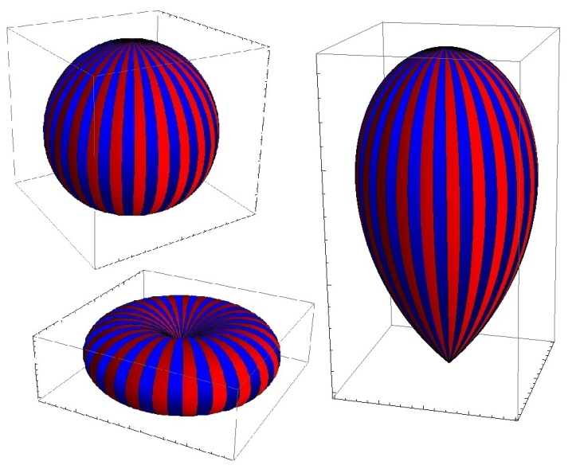
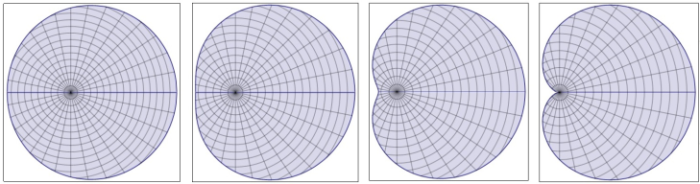
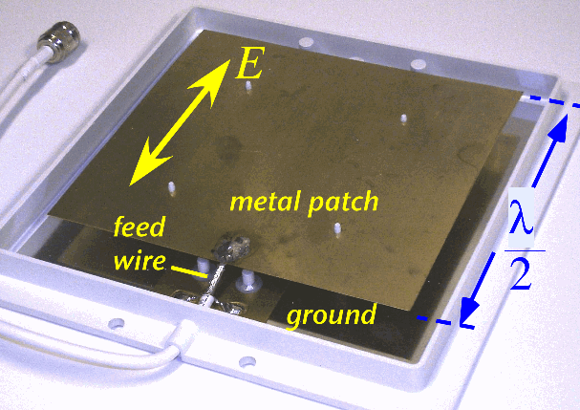

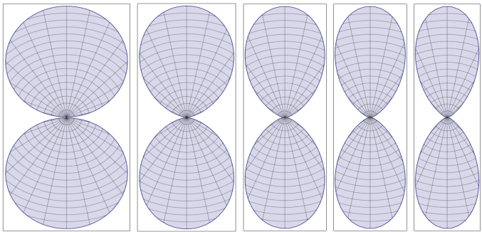

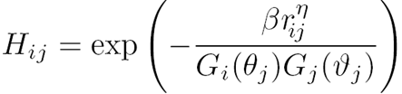

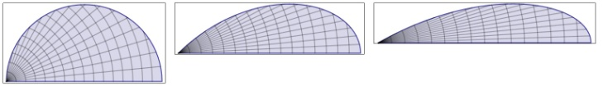

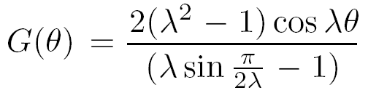
Anisotropically radiating nodes
Patch
Dipole
Antenna Tx
and Rx gains
Normalization:
Horn
C.A. Balanis, Advanced engineering electromagnetics. Vol. 111. John Wiley & Sons, 2012.

Slide 21
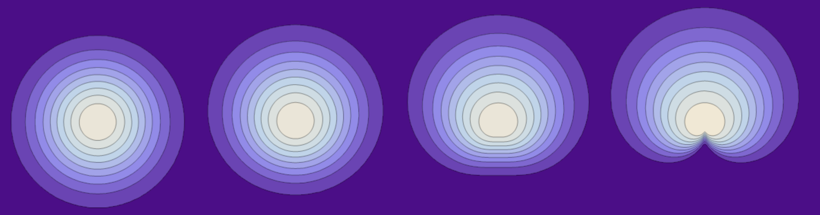
Anisotropically radiating nodes
Patch
C.A. Balanis, Advanced engineering electromagnetics. Vol. 111. John Wiley & Sons, 2012.

Slide 22


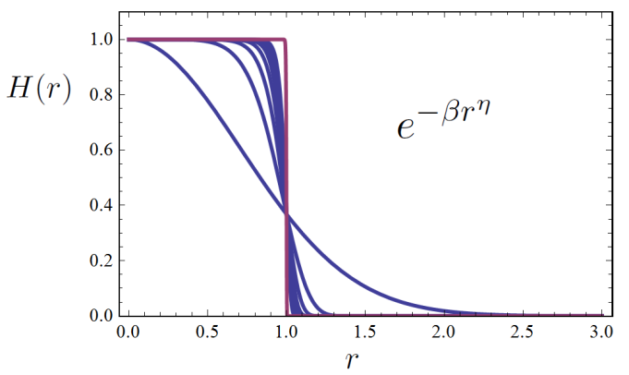
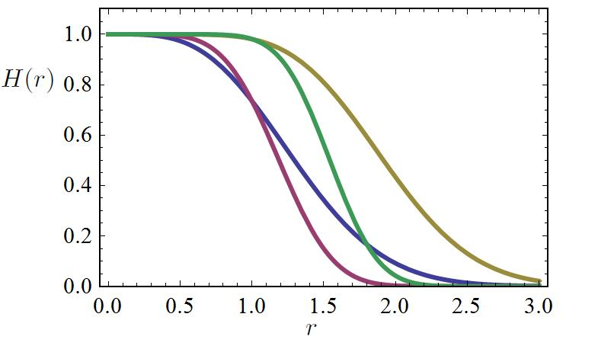


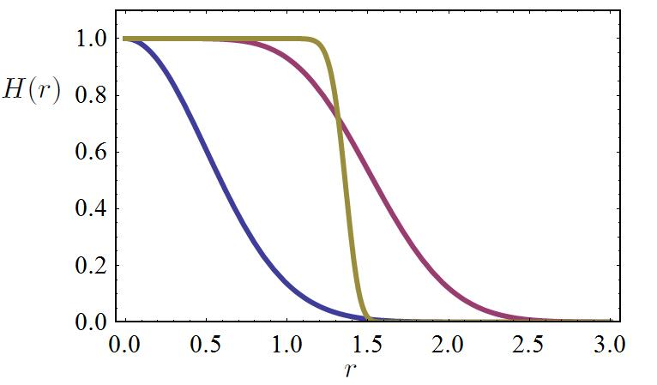
Multiple antennas
1) Single Input Single Output (SISO)
2) Single Input Multiple Output (SIMO/MISO)
m=2, 2, 4, 4
η=2, 3, 2, 3
3) Multiple Input Multiple Output (MIMO-MRC) with 2 receiving and n transmitting antennas (or vice versa)
n=2, 5, 10
η=2, 2, 6

Slide 23

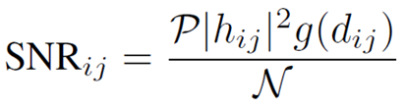
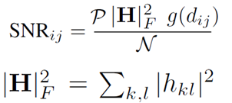

Multiple antennas
2) Single Input Multiple Output (SIMO/MISO)
SISO:
m=2, 2, 4, 4
η=2, 3, 2, 3
MIMO: (STBC)
χ² distributed with 2mn dof

Slide 24
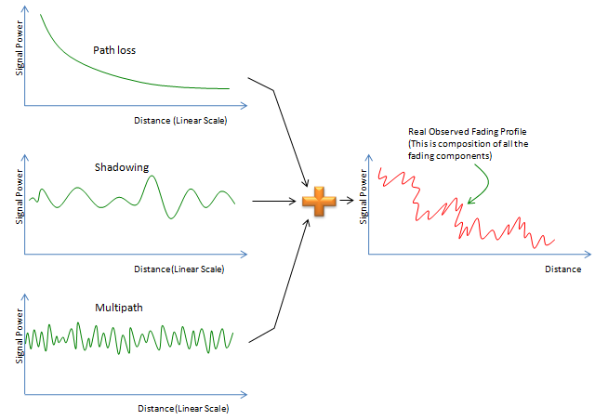


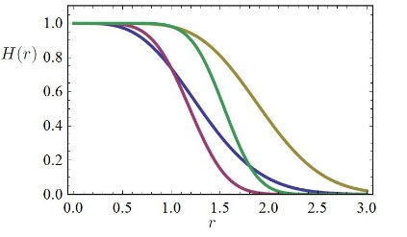
Modelling ad hoc (random) networks
A short summary:
A Statistical framework
Pairwise Connection probability
  Soft vs Hard
  Rician and Rayleigh fading
  Directional antennas
  Multiple antennas

Slide 25




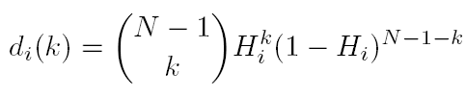




Local Network Observables
The probability of some node i connecting with some other node
Pair formation probability: The probability that two randomly selected nodes connect to form a pair
The probability that node i connects with exactly k other nodes - degree distribution
Mean degree

Slide 26


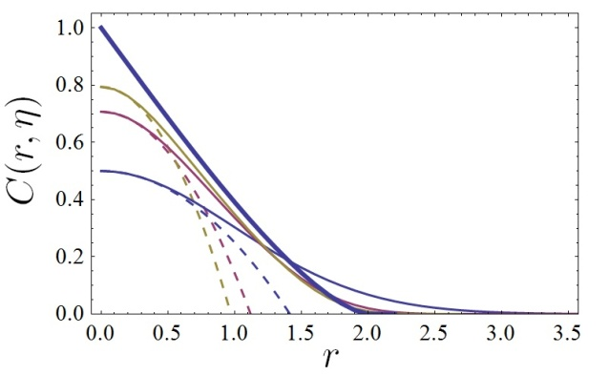

Local Network Observables
2-node correlation function
1
Probability that node 1 connects with node 3, given that node 1 is connected with node 2:
2
3
η = 2, 4, 6, ∞
Nearby nodes are less correlated for soft connectivity functions

Slide 27

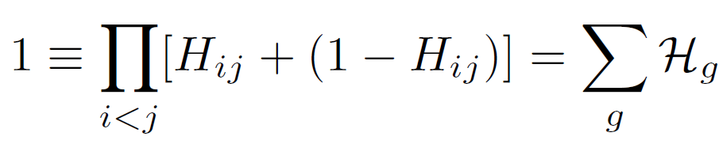
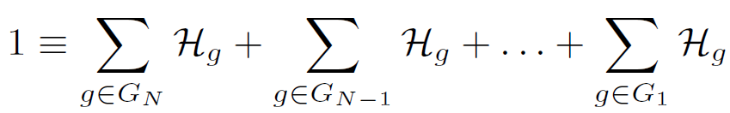


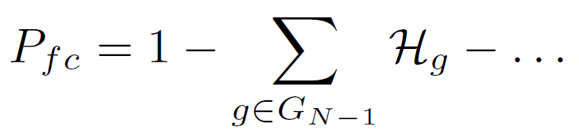
A cluster expansion in 3 simple steps
1) Start with the probability of two nodes being connected (or not)
2) Multiply over the complete graph to get the probability of all possible combinations giving 2^{N(N-1)/2} terms
Global observables:
Given a graph, what is the probability of achieving full connectivity?
A graph is fully connected if there exists at least one multi-hop path connecting every two nodes.
3) Group into collections of terms determined by their largest cluster
(Erdӧs 1959)
4) At high densities full connectivity is simply the complement of the probability of an isolated node.
Full Connectivity: Corners, edges and faces, Journal of Statistical Physics, 147 (4), 758-778, (2012)

Slide 28
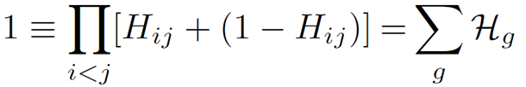
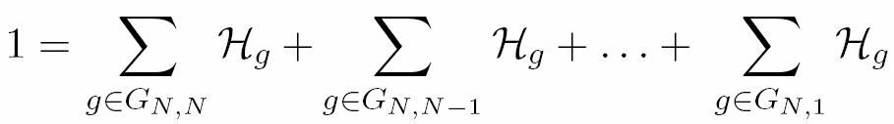
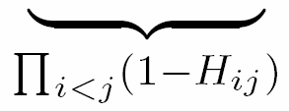
Start with the probability of two
nodes being connected (or not):
Multiply over the complete graph to get
the probability of all possible combinations:
Step 1
Step 2
i
j
At high densities, full connectivity is the complement of an isolated node:
3. Group into collections of terms determined by their largest cluster:
Step 3
G_{3, 3}
G_{3, 2}
G_{3, 1}

Slide 29
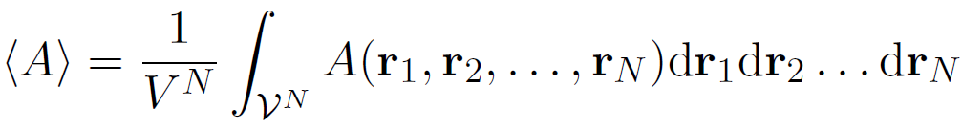
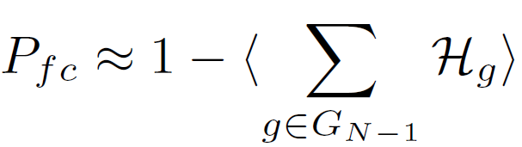

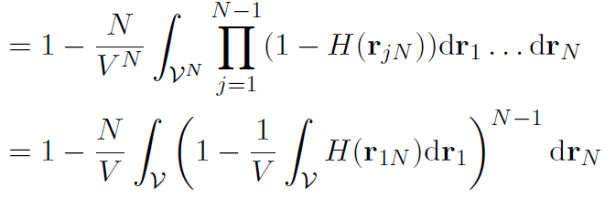
A cluster expansion in 3 simple steps
Define an average over all possible configurations
1) Node N is not connected to any of the other N-1 nodes
3) Since we are comparing pairs of nodes, N-2 integrals can be decoupled through a change of variables:
2) Multiply by N since all nodes are identical

Slide 30



The Homogeneous case
Assuming that the network is homogeneous, implies that there are no boundaries and therefore the system is symmetric under translational transformations. This allows for a final change of variables and we are left with a single integral:
Example of a homogeneous network space: Surface of a Sphere

Slide 31


K-connectivity - Reliability
k-connectivity: network remains fully connected if any k-1 nodes are randomly removed
1-connected
2-connected
3-connected

Slide 32





K-connectivity - Reliability
The probability of network having minimum degree k
(1 - probability node has degree at most k-1)^N
k-connectivity for confined random networks, Europhysics Letters, 103, 28006, (2013)

Slide 33





K-connectivity - Reliability
Q. What about ?
A. and have the same asymptotic distribution.
Since 2-connectivity implies 1-connectivity
X(1) = probability of obtaining a fully connected network which is not 2-connected.
At high densities, a fully connected network which is not 2-connected will typically contain a single node which is of degree 1.
Repeating this argument k times:

Slide 34
K-connectivity - Reliability
The probability of network having minimum degree k

Slide 35


Modelling ad hoc (random) networks
A short summary:
A cluster expansion in 3 simple steps
Full connectivity (homogeneous case)
Local Network Observables
  Pair formation
  Mean degree
  2-node correlation function
k-connectivity
1-connected
3-connected
2-connected

Slide 36
Tutorial Outline
Introduction / Motivation
  Why, when and where decentralized can be better? Example applications
Modelling Random Networks
  Setup and definitions, Network observables (coverage, node degree, k-connectivity)
From Infinite to Finite Networks
  Asymptotics, Boundary effects, Examples
  Complex and fractal geometries
Advanced Topics
  Scaling laws, Directional antennas, Small openings
Future directions and challenges

