Slide 1
Examining associations between gestational weight gain, birthweight and gestational age.
Kate Tilling, Corrie Macdonald-Wallis, Andrew Smith, Abigail Fraser, Laura Howe, Tom Palmer and Debbie Lawlor

Slide 2
Weight gain during pregnancy
Clinical questions:
What is the average pattern of weight gain during pregnancy?
How much variation is there around this?
How is weight gain related to outcomes (e.g. birthweight)?

Slide 3




The Avon Longitudinal Study of Parents and Children - ALSPAC

Slide 4
Study Design
Population Based Birth cohort
University of Bristol – School of Social and Community Medicine
14,000 pregnant women
Expected data of delivery: April 1st 1991 - Dec 31st 1992
Living in Avon in South West England

Slide 5
ALSPAC study - GWG
11,702 term, singleton, livebirths surviving to at least 1 yr of age consented to data abstraction
6 midwives abstracted data from obstetric medical records
Number of measures varies by gestational age:
1106 women had weight <8 weeks
105 had weight>42 weeks.
Number of measures varies between women:
Median number measures 10 (IQR 8, 11)

Slide 6
Weight gain during pregnancy
1) total weight gained
2) rate of weight change
3) compliance with IOM recommendations
Pre-pregnancy BMI | Recommended weight gain (kg)
<18.5kg/m² | 12.5-18
18.5-24.9kg/m² | 11.5-16
25-29.9kg/m² | 7-11.5
>=30kg/m² | 5-9

Slide 7
Gestational weight gain

Slide 8
IOM and length of gestation
Length of gestation:
0.26 weeks shorter for <IOM rec
0.10 weeks longer for >IOM rec
Could be just artifact:
IOM based on difference between last and first weight measures
If born early, last weight measure will be lower.

Slide 9
Limitations of ‘standard’ methods
All require baseline and final weights taken at same gestational ages.
None investigate pattern of weight change.
Confounding with length of gestation
Standard methods tell us nothing about the pattern of change within individuals

Slide 10
Multi-level linear models
y_{ij} = a + u_{0i} + (b+u_{1i})t_{ij} + e_{ij}
y_{ij}=weight for individual i at occasion j, time t_{ij}
Effect of time varies between individuals (u_{1i})
The model estimates:
The average regression coefficients a and b
Individual intercepts (a + u_{0i})
Individual slopes (b+u_{1i})
The covariance between the intercept and slope

Slide 11
Shape of trajectory
Linear – random intercept and slope.
May be unrealistic
Polynomial – with/without random effects
Which polynomial terms to include?
Simple polynomial may not be realistic
Fractional polynomial +/- random effects
May not fit well at extremes, affected by outliers.
Splines +/- random effects

Slide 12
Best fit polynomial has powers 3 and 33

Slide 13
Linear spline multilevel models
Model the data as piecewise linear, i.e. define periods of time during which growth rates are approximately linear
Simplification of the true curve
Produces easily interpretable coefficients when related to earlier exposures or later outcomes
Choice of number/place knots.

Slide 14
Multilevel linear spline model
y_{ij} = a + u_{0i} + ∑(β_{k}+u_{ik})s_{ijk}+ e_{ij}
y_{ij}=weight for individual i at occasion j, time t_{ij}
The model estimates:
Individual intercepts
Individual slopes between each set of knot points
Variance in the intercept and slopes
The covariances between the intercept and slopes
Variance of the level-1 residuals (measurement error: allowed to vary with time)
Notes:
Level 1 residuals = measurement error

Slide 15
Gestational weight gain
Fractional polynomials used to find best-fitting pattern of weight gain
Linear splines used to approximate curve
Knots positioned at whole weeks of gestational age.
Optimal knotpoints at 18 and 28 weeks
For each individual, model estimates pre-pregnancy weight, weight gain from 0-18, 18-28 and 28-40 weeks

Slide 16
Pattern of weight gain
0.56 kg/wk
0.31kg/wk
0.52 kg/wk

Slide 17
Model fit
Gestational age (weeks) | Number of measures | Actual weight (mean (sd)) | Observed-predicted (mean (sd)) | Observed-predicted (95% range)
<8 | 1,106 | 64.5 (12.4) | 0.29 (0.7) | -0.8, 1.4
8-13 | 8,723 | 64.4 (11.9) | -0.02 (0.7) | -1.1, 1.0
13-18 | 11,023 | 65.6 (11.7) | -0.09 (0.7) | -1.3, 1.1
18-23 | 10,141 | 68.0 (11.8) | 0.07 (0.8) | -1.1, 1.2
23-28 | 11,570 | 70.7 (11.8) | 0.07 (0.8) | -1.2, 1.3
28-33 | 17,467 | 73.0 (11.8) | -0.06 (0.8) | -1.3, 1.2
33-38 | 20,273 | 75.4 (12.0) | 0.02 (0.8) | -1.2, 1.2
>38 | 10,419 | 77.5 (12.1) | 0.00 (0.7) | -1.1, 1,2

Slide 18
Parity and weight gain

Slide 19
Birthweight and GWG
BWT Mean=3.45kg, SD=0.52kg N= 9398
Regression of BWT on pre-pregnancy weight, IOM guidelines and covariates
BWT increased by 0.006kg for each 1kg increase in pre-pregnancy weight
BWT decreased by 0.17kg if GWG<IOM rec
BWT increased by 0.11kg if GWG>IOM rec

Slide 20
Joint Model for GWG and BWT
GWG
Weight_{ij}= (a+u_{0i}) + (b+u_{1i})s_{1i} + (c+u_{2i})s_{2i}
+ (d+u_{3i})s_{3i} + other covariates + e_{ij}
BWT
BWT_{i}=(α+v_{i}) + other covariates + e_{i}

Slide 21
Joint Model GWG/BWT
Random effects matrix – allows BWT and GWG to be correlated
Estimate variances and covariances of:
u_{0i} – individual deviation from mean pre-pg wt
u_{1i} – individual deviation from mean GWG 0-18wk
u_{2i} – individual deviation from mean GWG 18-28wk
u_{3i} – individual deviation from mean GWG 28+wk
v_{i} – individual deviation from mean BWT

Slide 22
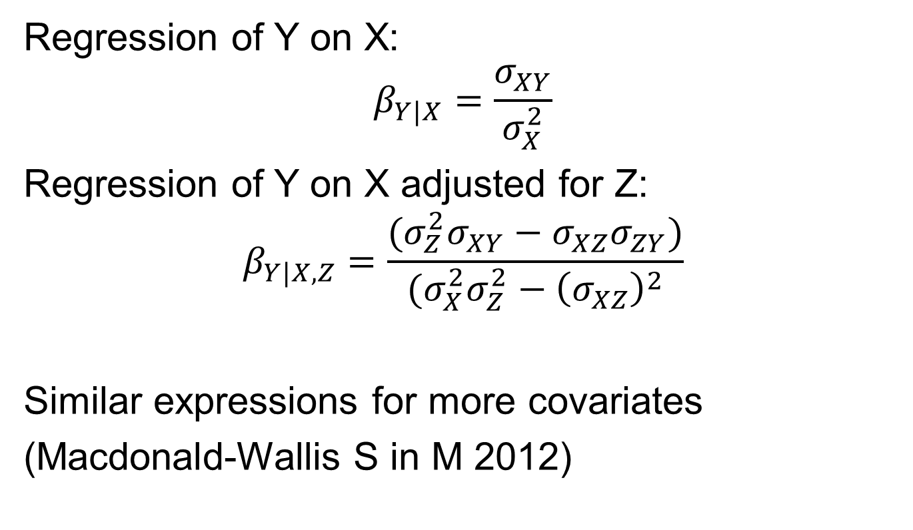
Digression – regression coefficients
Regression of Y on X:
$$β_{Y|X}=\frac{σ_{XY}}{σ_{X}^{2}}$$
Regression of Y on X adjusted for Z:
$$β_{Y|X,Z}=\frac{(σ_{Z}^{2}σ_{XY}−σ_{XZ}σ_{ZY})}{(σ_{X}^{2}σ_{Z}^{2}−{\left(σ_{XZ}\right)}^{2}}$$
Similar expressions for more covariates
(Macdonald-Wallis S in M 2012)

Slide 23
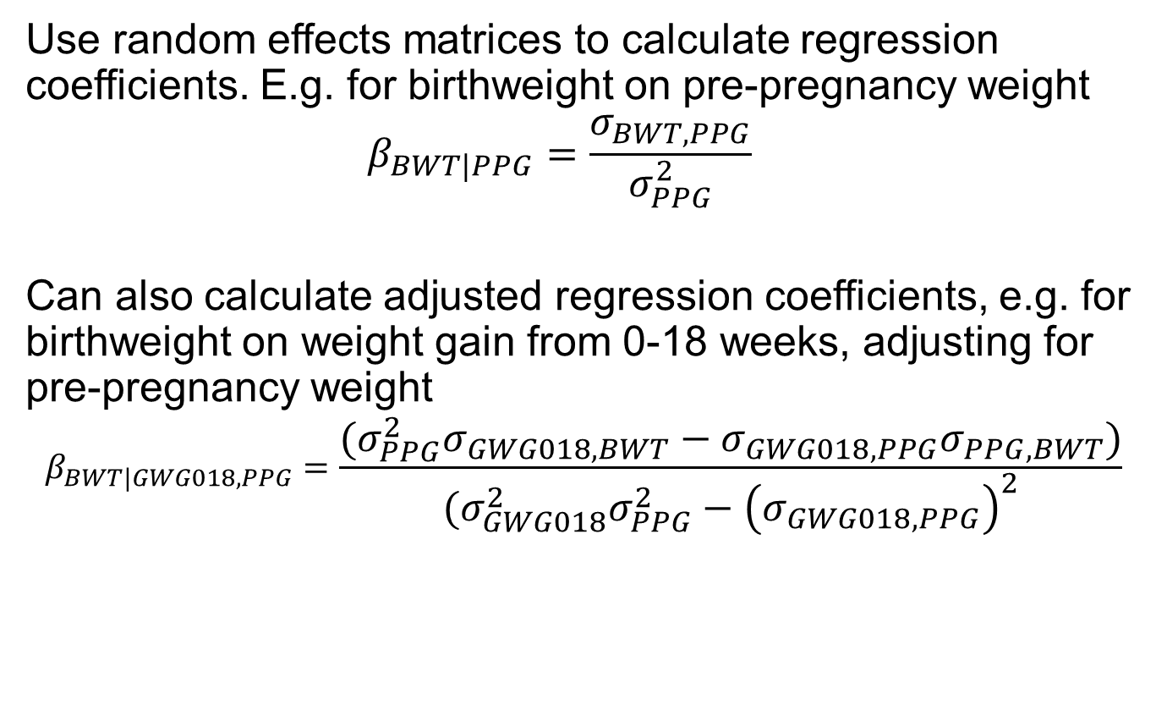
Joint Model GWG/BWT
Use random effects matrices to calculate regression coefficients. E.g. for birthweight on pre-pregnancy weight
$$β_{BWT|PPG}=\frac{σ_{BWT,PPG}}{σ_{PPG}^{2}}$$
Can also calculate adjusted regression coefficients, e.g. for birthweight on weight gain from 0-18 weeks, adjusting for pre-pregnancy weight
$$β_{BWT|GWG018,PPG}=\frac{(σ_{PPG}^{2}σ_{GWG018,BWT}−σ_{GWG018,PPG}σ_{PPG,BWT})}{(σ_{GWG018}^{2}σ_{PPG}^{2}−{\left(σ_{GWG018,PPG}\right)}^{2}}$$

Slide 24
Confidence intervals?
Non-linear combination of variances and covariances
Draw from the random effects matrix and use centiles of the realisations
Both implemented within Stata (reffadjust)

Slide 25
Joint Model GWG/BWT
Fixed effects
GWG greater in | BWT greater in
Nulliparous women | Multiparous women
Non-smokers | Non-smokers
Women who give up smoking
Taller women | Taller women
Mothers of male offspring | Male offspring

Slide 26
Joint Model GWG/BWT
Random effects variance/covariance matrix:
 | BWT cons | Pre-pg wt | GWG 0-18 | GWG 18-28 | GWG 28-40
BWT cons | 0.24
Pre-pg wt | 0.89 | 138
GWG 0-18 | 0.013 | -1.02 | 0.05
GWG 18-28 | 0.015 | -0.45 | 0.012 | 0.04
GWG 28-40 | 0.011 | 0.023 | 0.005 | 0.018 | 0.04

Slide 27
Joint Model GWG/BWT
Regression of birthweight (mean 3.4 (0.52) kg) on:
GWG | Mean (SD) | Unadjusted | Adjusted for previous GWG
Pre-pregnancy wt (kg) | 60.7 (12.3) | 0.006 (0.0004)
Wt gain 0-18 weeks (kg/wk) | 0.31 (0.18) | 0.26 (0.03) | 0.47 (0.03)
Wt gain 18-28 weeks (kg/wk) | 0.54 (0.17) | 0.42 (0.03) | 0.42 (0.04)
Wt gain28-40 weeks (kg/wk) | 0.47 (0.20) | 0.26 (0.03) | 0.03 (0.03)

Slide 28
Joint model GWG/BWT
Use random effects matrices to calculate regression coefficients.
E.g. β(BWT/weight at time t)
and
β(BWT/weight at time t, adjusting for pre-pregnancy weight)

Slide 29
Joint model GWG/BWT
Unadjusted regression coefficients for BWT on GWG with gestational age

Slide 30
Joint model GWG/BWT
Regression coefficients for BWT on GWG with gestational age, adjusted for pre-pregnancy wt

Slide 31
Joint models
Can be formulated to give equivalent results to SEMs
Assume:
Normal distributions
Linear relationships
No interactions

Slide 32
One alternative
Use level-2 residuals as exposures
Lifecourse models (Mishra et al IJE)
A structured approach to modelling the effects of binary exposure variables over the life course Gita Mishra et al, Int J Epidemiol. 2009 April; 38(2): 528–537.
Methods:
Fit saturated model for outcome on binary exposures
Compare this (P-values) to nested, simpler models corresponding to specific hypotheses
Select the model which best fits the data

Slide 33
Lifecourse models for continuous exposures
Nested models (potentially large number of possibilities – specify a priori!)
Outcome depends on:
Accumulation – total period of time in adverse exposure
Critical period – only exposure in one period of time
Sensitive period – exposure at each time related to outcome, but stronger relationship for specific periods
Change model –moving from exposure to non-exposure (or vice-versa)

Slide 34
BWT as outcome, continuous exposures
Model | AIC | R-squared
Indep effects | 12440.7 | 17.3%
“Saturated” | 12390.3 | 17.8%
Accumulation | 12495.7 | 16.8%
Critical period - early | 12606.3 | 15.8%
Critical period - mid | 12570.1 | 16.1%
Sensitive period – late* | 12438.7 | 17.3%
* Early=mid, no effect of late GWG

Slide 35
Model selection approach
Begin with a list of potential hypotheses
Encode these hypotheses as variables
E.g. Critical periods s1, s2, s3 Accumulation AUC
Pre-pregnancy weight
Total weight gained
Perform variable selection
Put all variables into a model and see which has the biggest effect
Likely to have more variables than can fit in a saturated model. Therefore need to penalize variables.

Slide 36
The lasso
Least Absolute Shrinkage and Selection Operator
Whilst linear regression minimizes (y – Xβ)² the lasso minimizes (y – Xβ)² + λ|β|
Parameter estimates are shrunken or zero (sparse estimates)
Implement in R using the lars package
Notes:
Lambda is a smoothing parameter. There is always a lot of debate about how to choose it, which is probably why the lasso is not used much in epidemiology. However the choice will be unimportant here because I will be looking at how the estimates change as the smoothing parameter changes, which is one of the outputs of the lars package

Slide 37
The lasso
Chooses the variable most correlated with the outcome
Therefore (on average) chooses the hypothesis that best explains the data
As model complexity increases, further variables enter the model that may suggest more compound hypotheses
Plotting R² against number of variables hints at how many variables to choose (elbow plot)
Notes:
It has been proved that the lasso will choose the variable that best explains the data. Therefore we conclude that the hypothesis represented by that variable offers the best explanation for the effect of the exposure over the life course
There is always a single answer. Under the Mishra et al approach, there may be several hypotheses that ‘pass the test’ – meaning there may be several hypotheses with p-values above the threshold. Under this approach there is never the situation of having to choose between hypotheses. The Mishra et al approach compares each hypothesis against a saturated model, which may or may not have a strong association with the outcome. If there is one number that this approach relies on, it’s the R-squared value, which (in this approach) one looks at straight away and therefore straight away can see if its too small.

Slide 38
BWT as outcome, continuous exposures

Slide 39
Conclusions
Elbow is at 2 additional variables
BWT best explained by pre-pregnancy weight and the interaction between pre-pregnancy weight and total GWG.
Both are positively associated with birthweight and they interact positively, so that the difference in birthweight per additional unit of absolute GWG is greater in women who have a higher pre-pregnancy weight

Slide 40
Conclusions
Can model several outcomes jointly (have also modelled trivariately with length of gestation)
Calculating regression coefficients straightforward (expressions get complex)
Confidence intervals – either nlcom or simulation give results similar to equivalent SEMs
Avoids problem of length of gestation being related to total weight gain
Lifecourse models – can include interactions and higher-order effects

Slide 41
Answering the clinical questions
What is the average pattern of weight gain during pregnancy?
How much variation is there around this?
How is weight gain related to outcomes (e.g. birthweight, offspring weight at age 9)?

